Slide 1
NYC Taxi Fare Prediction
Qixiang Zhou
Yujun Xie

Slide 2
Use Case
Estimate taxi fare when doing travel plan
Embed in web page for website like Booking, TripAdvisor.
Compare the price with bus, Uber, Lyft.

Slide 3
Methodology
Ingest data set to data model with Scala
Build data model with Spark ML APIs
Run the system with training data set
Input test data set and generate successful prediction rate
Build a web page, with Google Map API to present the trained model

Slide 4
Data Description
Data set is from Kaggle: https://www.Kaggle.com/c/new-york-city-taxi-fare-prediction/data
Data file size: 5.7 GB
Number of rows: 1,300,000 lines
Columns features(5 features):
pickup_longitude, pickup_latitude, dropoff_longitude, dropoff_latitude, passenger_count
Target: fare_amount

Slide 5
Milestones
Start project and build git repository(week 10)
Configure work environment and decide ML algorithm(week 11)
Parse and ingest taxi fare data with Scala(week 12)
Build machine learning model and process training data(week 12)
Test data model and get prediction result(week 13)
Build web page to present the work(week 14)

Slide 6
Repository
Github: https://github.com/JIMsZHOU/CSYE7200_FinalProject_Team8
The whole project will be majority code in Scala (based on Spark and Play-2.0) and with HTML, JavaScript and Java

Slide 8
Project Demo – web application
For pickup/dropoff coordinate, user can either fill with latitude and longitude numbers or mark locations in the Google Map API then click ‘position’
For Passenger Number, user should choose a number range from 1 to 6 (since in the training data set, 1 to 6 is the range of passenger number.)
With 5 features form filled, user can click check button to get system predicted taxi fare.
User is also able to create a new data by clicking update button with all the features form and target form filled.
The collected new data will expand original training data set and user can get a new data model for more accurate result based on expanded data set.

Slide 9
Gradient-Boosted Trees(GBTs)
The general idea of GBTs is to compute a sequence of (very) simple trees, where each successive tree is built for the prediction residuals of the preceding tree.
With a simple binary tree as the beginning, at each step of the boosting (boosting trees algorithm), a simple (best) partitioning of the data is determined, and the deviations of the observed values from the respective means (residuals for each partition) are computed.
The next 3-node tree will then be fitted to those residuals, to find another partition that will further reduce the residual (error) variance for the data, given the preceding sequence of trees.

Slide 10
Project Demo – data prase
For input data, we use sparkSession.read.csv method with “head” and “inferSchema” options to create a taxi fare training DataFrame
In order to get rid of invalid data, we filter out the row with the feature column equals zero.
To GBT algorithm model in spark ml library, the input feature col and label col should only be one. In order to make our four features data able to input this model, we use VectorAssembler to transform original dataFrame into a new DataFrame with only one vector feature.
Then, we create a Pipeline to specify our ML workflow and use fit method to generate training model with new dataFrame.

Slide 11
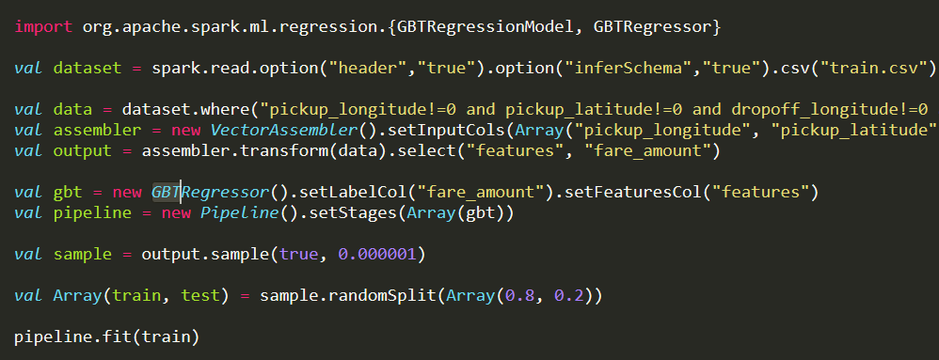

Slide 12
Acceptance Criteria
Root mean squared error will be less than 5.
The web page will react user within 5 seconds.

Slide 13
Result Assessment
The root mean squared error of data model’s prediction result is 4.245135277877846, which is lower than acceptance criteria 5
For generating prediction fare, the page respond time is around 470 ms which is much lower than 5 second in the acceptance criteria

